Slide 1
PROJECT PRESENTATION
RESORT MANAGEMENT SYSTEM
Jacob Mathew 22PMC127

Slide 2
ABSTRACT
Resort Booking is a web application that is created for booking rooms for the individuals. This will limit manual work and also make room allocation so much easier for the guests and staff off the resort. It manages data in the database and retrieves it whenever required.
We design this system at the request of the resort management, through this they do not require people to handle and calculate things. The developed system overcomes the drawbacks of manual room management it's said to be more user-friendly.
The modules are the Admin and User. This software Online Resort Management is developed using Python, Sqlite. Here, Python and Sqlite as back-end and HTML and CSS as front end. The software tools here is Microsoft SQL Server, here any web browser can be used. The development tool used here is pycharm.

Slide 3
REQUIREMENTS
REGISTRATION
LOGIN
ADMIN CAN MANAGE ROOMS
ADMIN CAN MANAGE USERS
ADMIN CAN VIEW THE RESORT OVERALL STATUS
USERS CAN VIEW ROOMS
USER CAN BOOK ROOM
USERS CAN CANCEL ROOM BOOKINGS

Slide 4
FEATURES AND HIGHLIGHTS
User is able to give the basic details name, address, phone number etc.
User can view the different type rooms its features, cost, capacity and so.
Admin can add, edit, delete the rooms.
User can book the rooms.
User can view the booking and cancel them if needed.
User can view the About page and contact page.
User can view the About page and contact page.
User can logout from the web application.
Admin can view the Dashboard.
Admin can view user profiles.
Admin can add view all bookings
Admin can know the room status as it is being updated each time.
Admin can change room status as available and not available.

Slide 5
TECHNICAL ASPECTS
Programming Language - python
Web Framework - django
Database(SqLite3)
Bootstrap
Jazzmin(DjangoAdmin)
Html, Css, JavaScript
3rd Part Libraries – Jazzmin,Pillow

Slide 6
ARCHETECTURE
Presentation Layer (Frontend) :
JavaScript – Handles Interactivity and client-side validation.
HTML/CSS – Responsible for user interface and styling.
Data Acess Layer :
Database Management System(DBMS) – Stores and manages systems data.
Relational Database(Sqlite) – Handles structured data related to users, bookings, etc..
Application Layer (Backend) :
Web Server – Receives HTTP request and and routes them to appropriate components.
Authentication and Authorization – Manage user authentication and authorization for secure access to system.

Slide 7
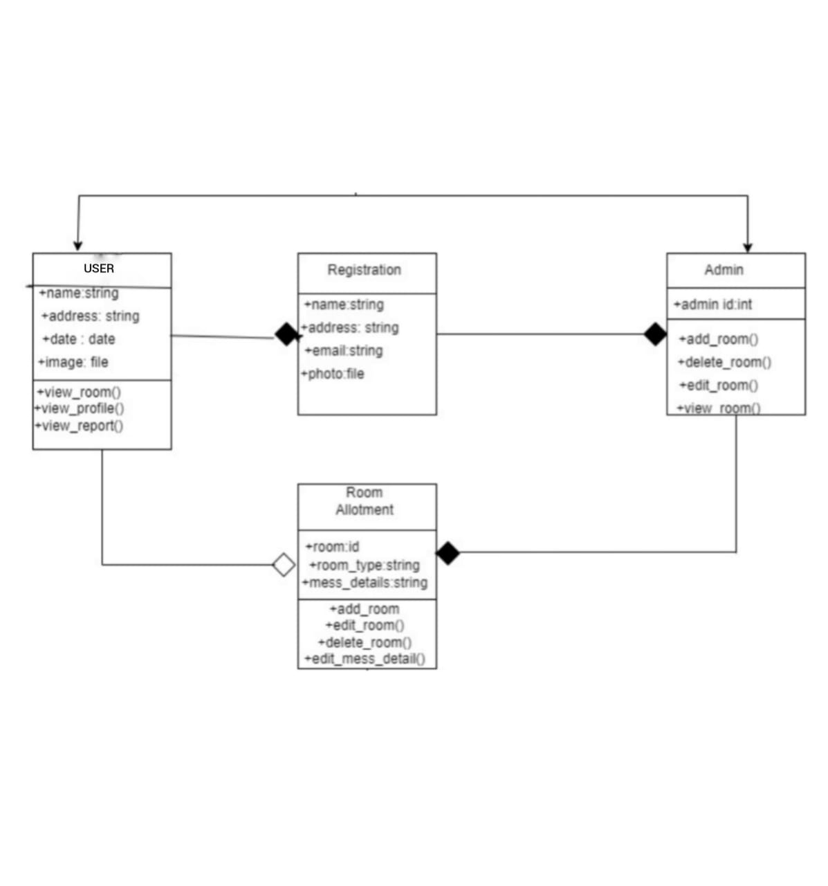
CLASS DIAGRM

Slide 8
CHALLENGES FACED
User Authentication and Security : Implementing a robust user authentication system with appropriate security measures can be a challenging task.
Validation Mechanisms : Implementing validation mechanisms helps ensure that user input is accurate and consistent.
Designing User Interface : Creating an intuitive and user-friendly interface is crucial for a successful bus booking system.
Database Design and Management : Designing an efficient database schema and managing the database operations can be complex.
Testing and Bug Fixing : Thorough testing is essential to identify and fix any bugs or issues in the system.

Slide 9
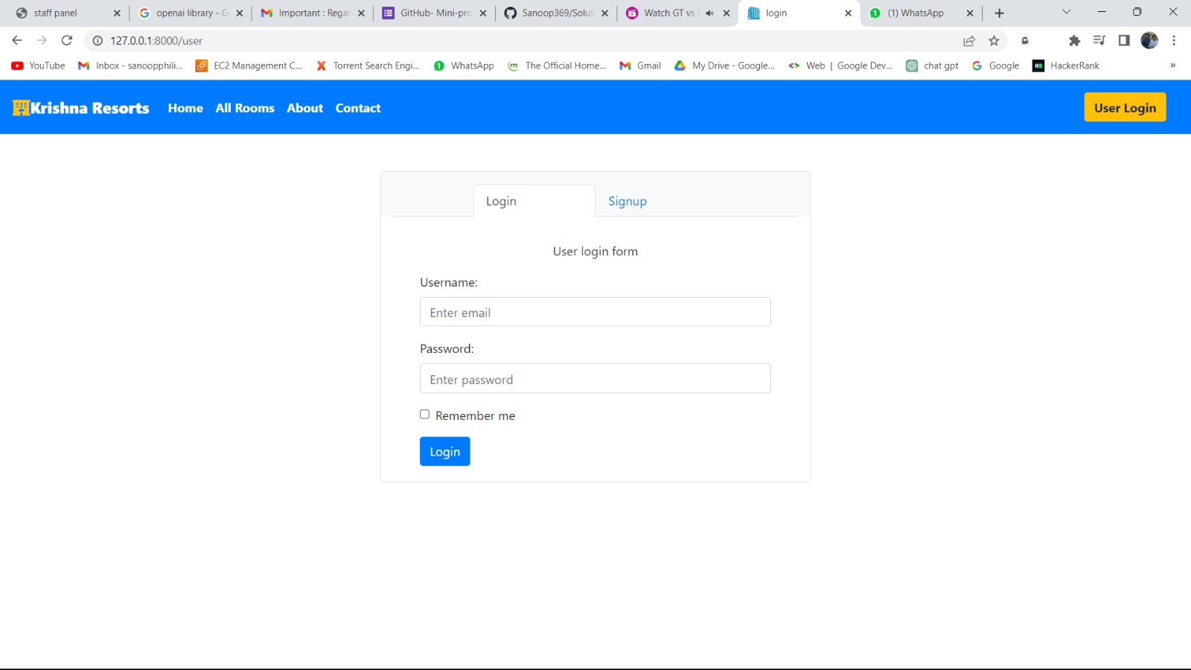
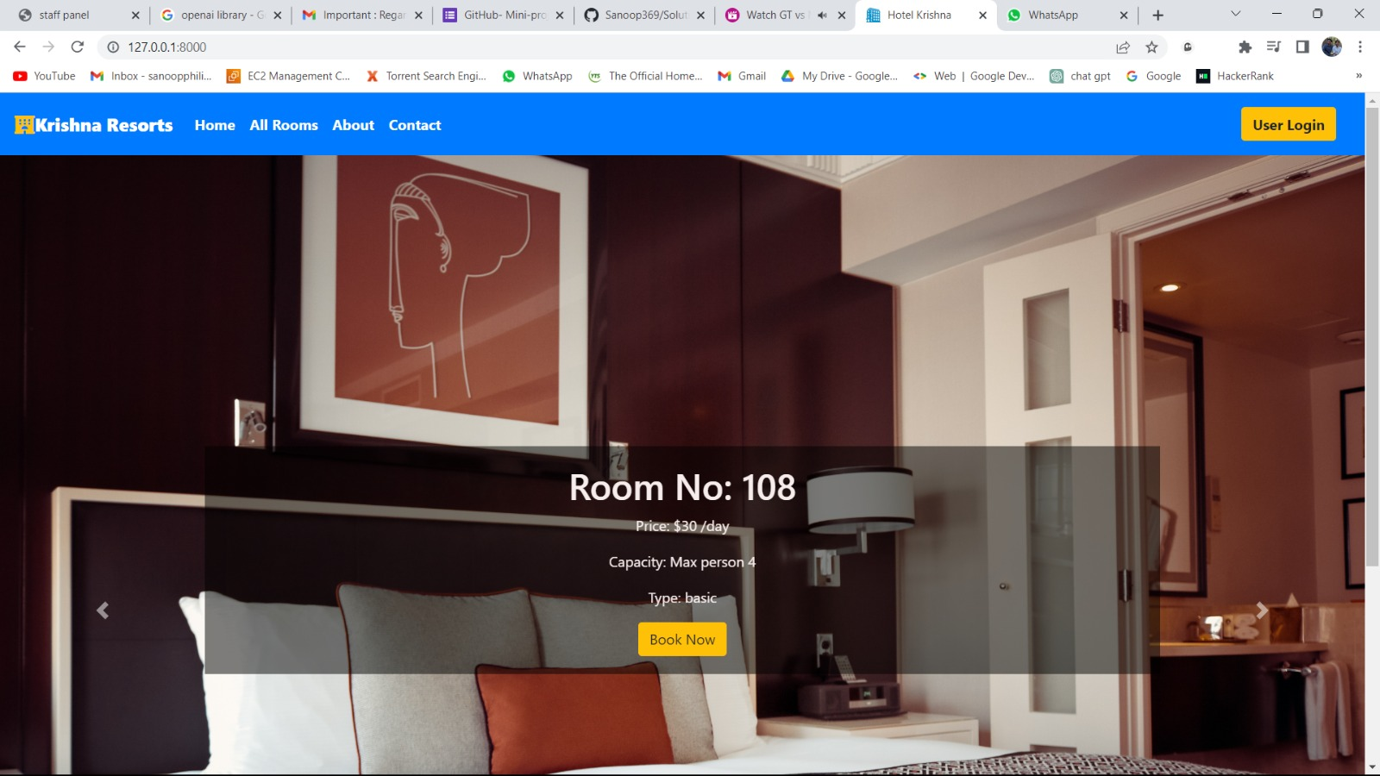
SCREENSHOTS
LOGIN PAGE
USER DASHBOARD

Slide 10
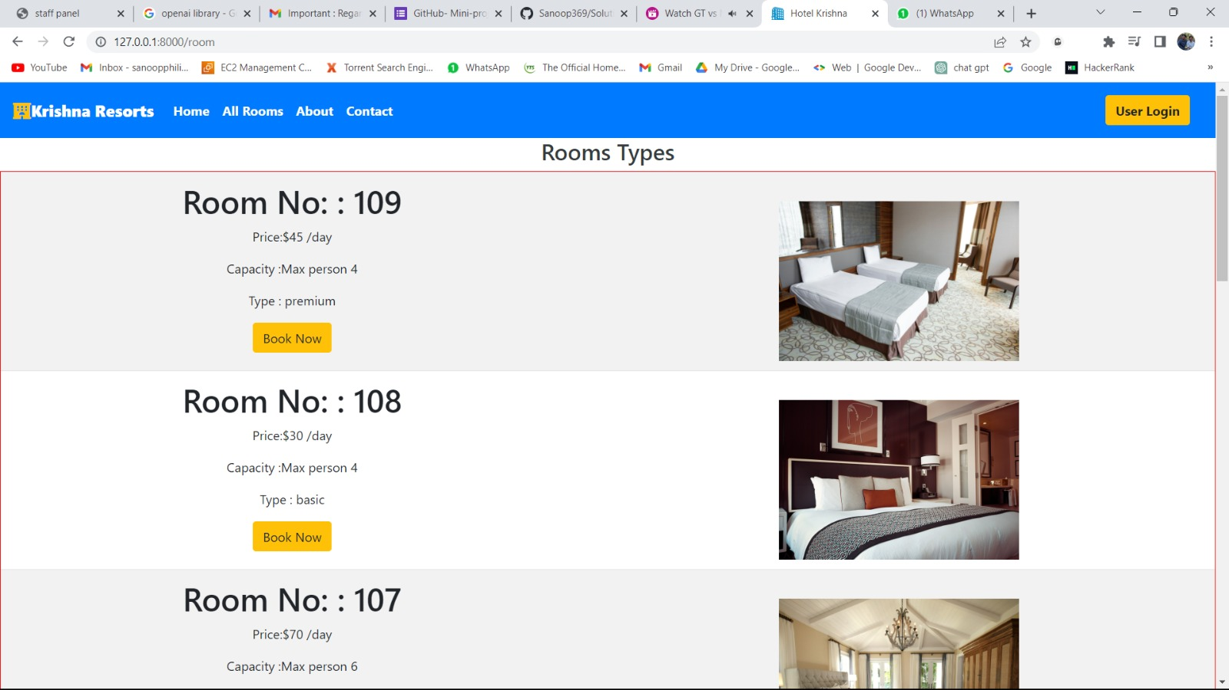
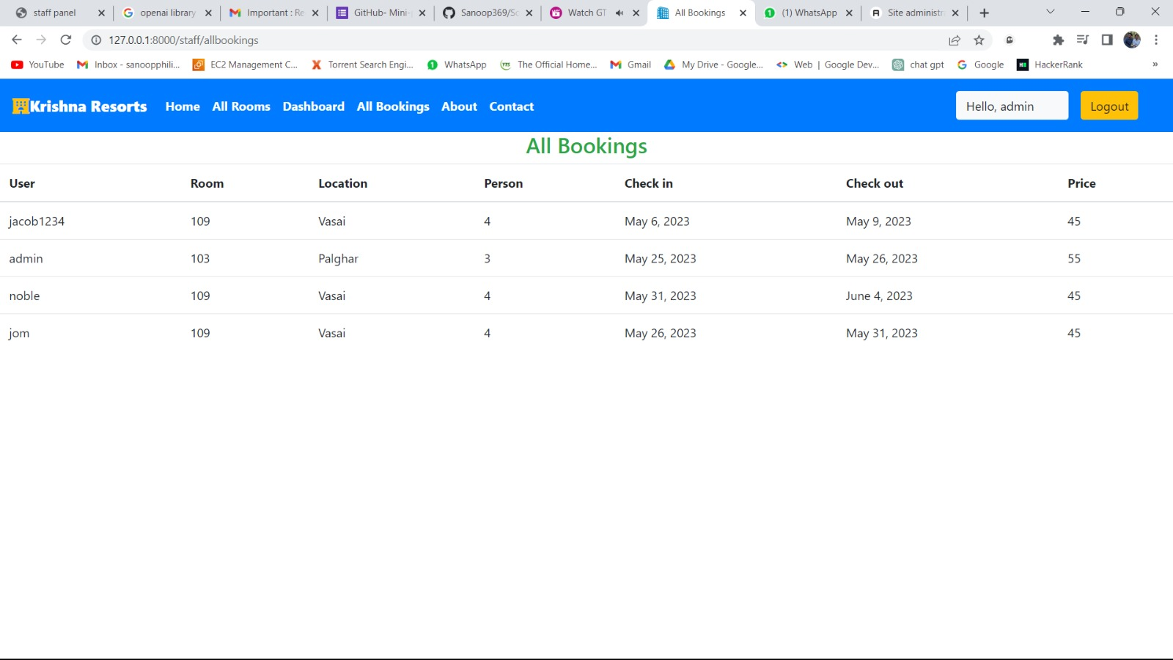
ROOMS
MY BOOKING

Slide 11
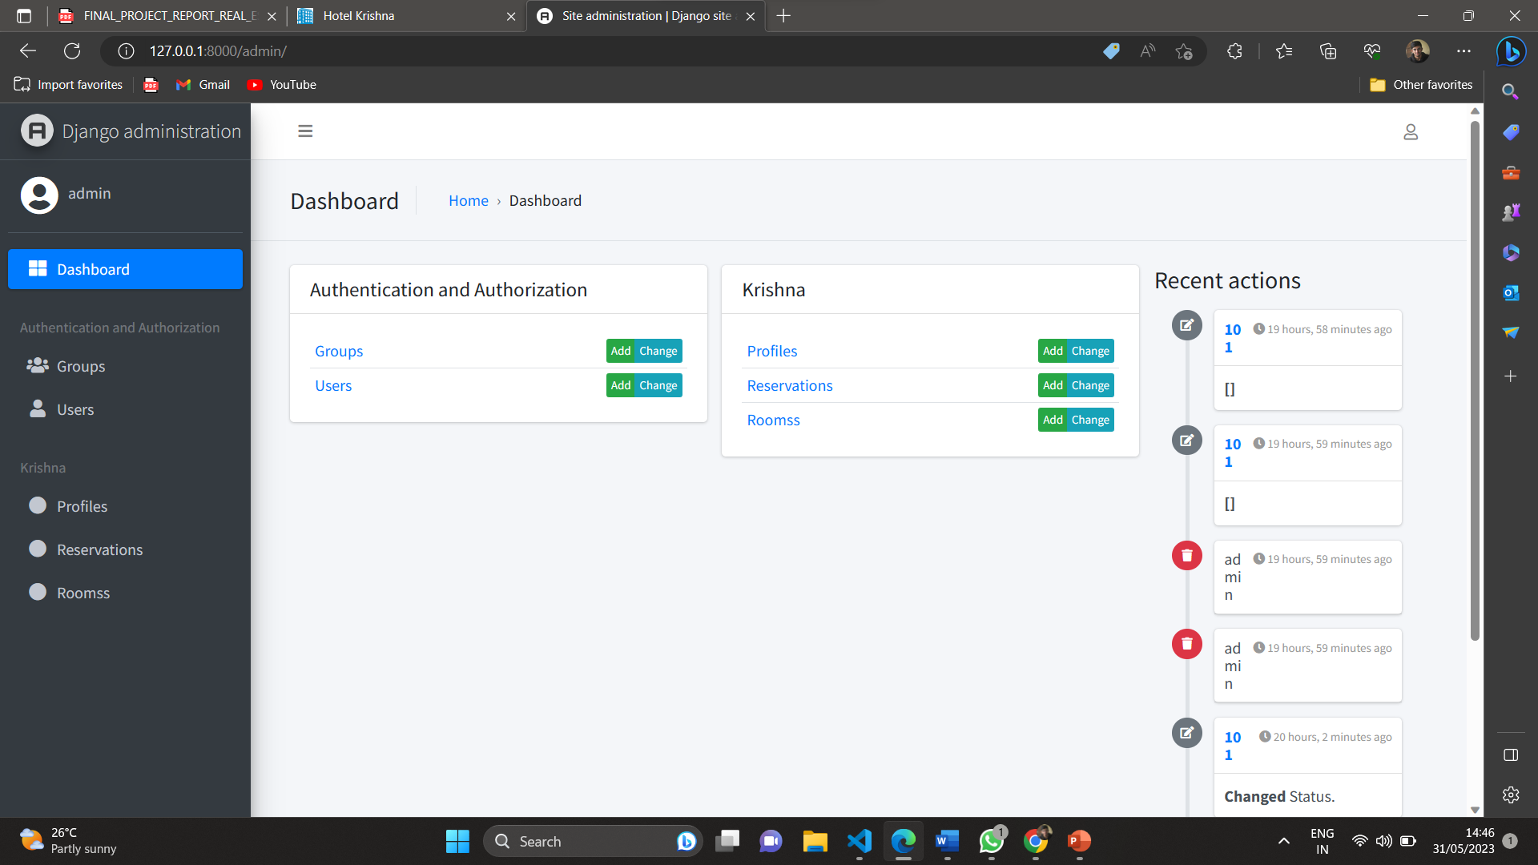
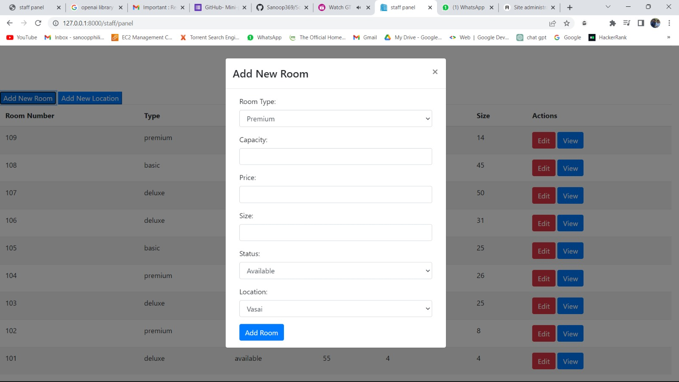
ADMIN DASHBOARD
ADD ROOM

Slide 12
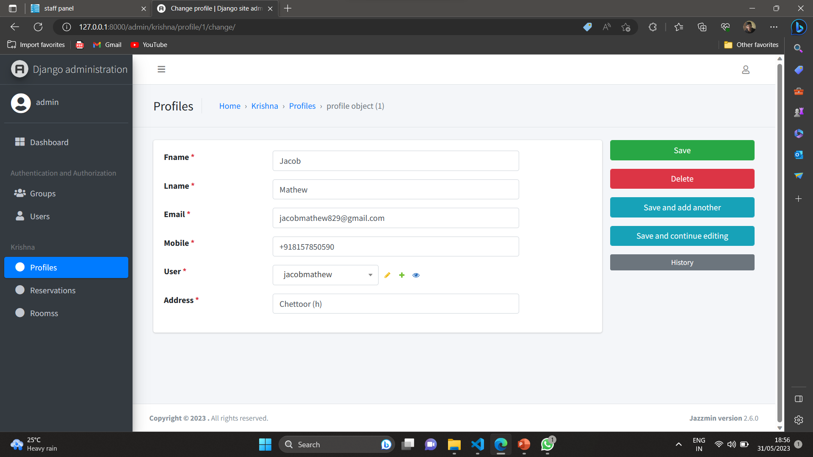
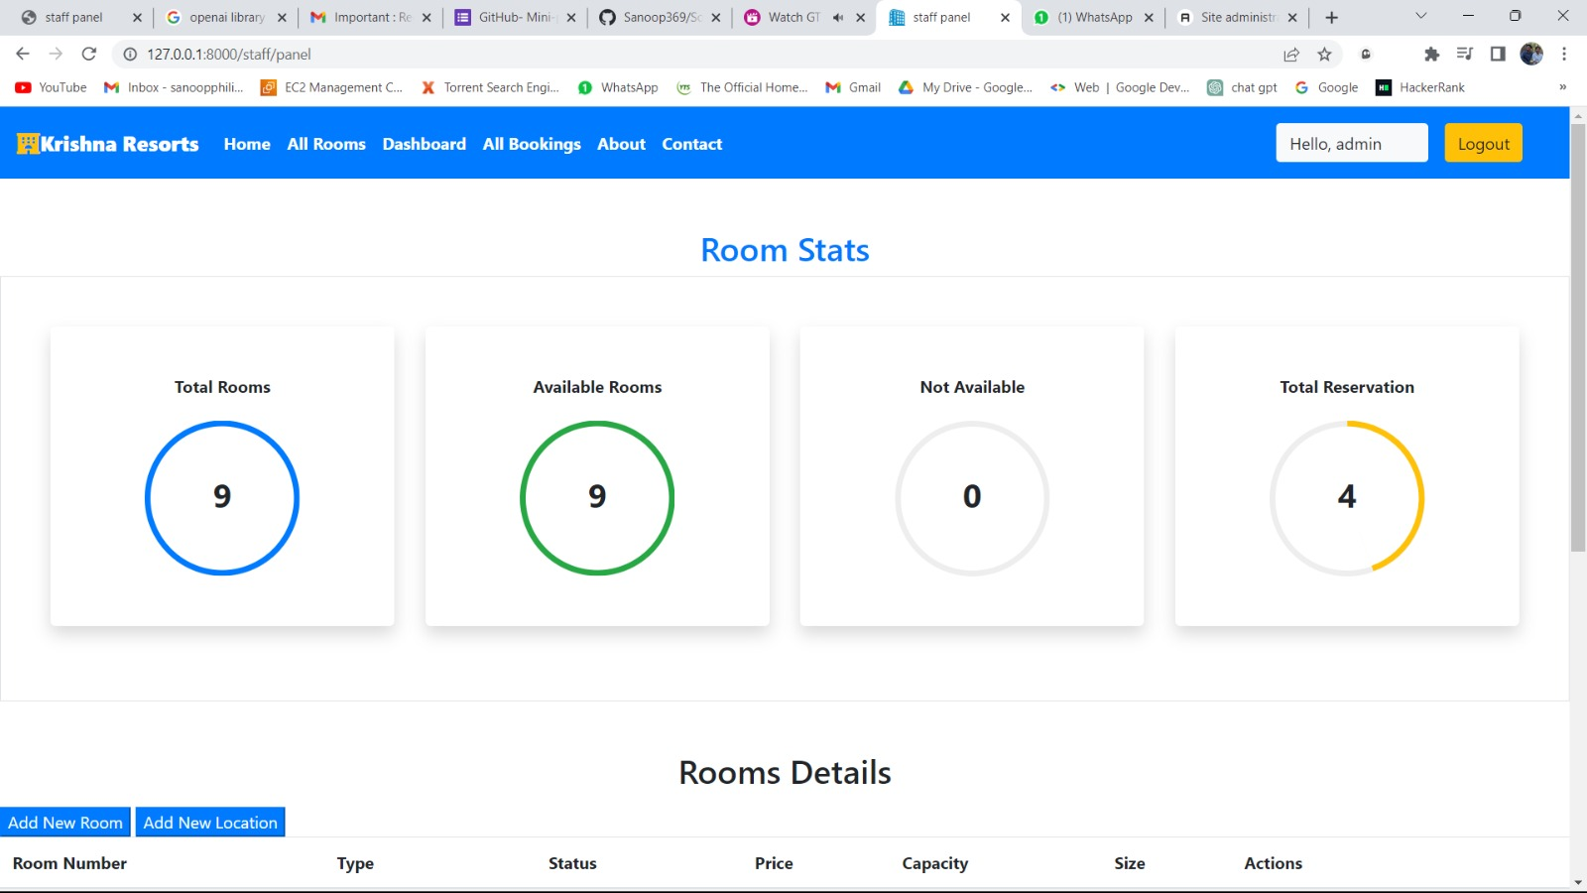
USER PROFILE
ROOM STATUS

Slide 13
FUTURE ENHANCEMANT
Payment and Billing System
Notification and Reminders
Generate Reports
Mobile Application
Integration with cashless payment system
Rating of Resort

Slide 14
CONCLUSION
The project aimed to create a user-friendly and efficient system for managing resort reservations, and it has successfully achieved this goal. Through the implementation of key features such as user registration, room search, booking, etc. The system streamlines the reservation process, eliminates manual tasks, and enhances the overall guest experience. Overall, the resort booking project demonstrates the effective utilization of technology to simplify resort reservations and improve operational efficiency. It serves as a valuable tool for the resort to manage bookings, monitor room availability, and provide a streamlined experience for its guests.

Slide 15
REFERENCES
http://www.oyorooms.com/
www.agoda.com
https://youtu.be/BqOang6oajg
https://1000projects.org/resorts-management-project-abstract.html
The GitHub repository link of project is : https://github.com/jacobmathewchettoor/hotel-booking

Slide 16
THANK YOU

